Slide 1

LDPC
DECODING FOR 5G NR
Lab Group-4 (Subgroup-2)
Mentor TA : Khushi Shah
Professor : Yash Vasavada
Course : CT-216 (INTRODUCTION TO COMMUNICATION SYSTEMS)

Slide 2
TABLE OF CONTENT
Honour Code
Group Members
Introduction to LDPC
LDPC In Standards
Base Matrices for 5G Standard
Expansion Factor (Z)
Encoding of Base Matrices
BPSK over AWGN Channel
AWGN and SNR
Demodulation
Puncturing and Rate matching
Hard Decision Decoding
Soft Decision Decoding and LLR
SISO Decoder For Repetiotion Code
15. SISO Decoder for (n, n-1) SPC Code
16. Min-Sum Approximation
17. Tanner Graph
18. Monte Carlo
19. Graphs for Bit Error Probability (BEP)
20. Graphs for Base Matrix NR_2_6_52
21. Graphs for Base Matrix NR_1_5_352
22. BER vs SNR for BPSK over AWGN Channel
23. Benefits of Encoded message over Uncoded message
24. Shannon Capacity Bound
25. Conclusion of Analysis
26. Improvement in the Min-Sum Decoding
27. Bibliography

Slide 3
Honour Code
We declare that:
→ The work that we are presenting is our own work.
→ We have not copied the work (the code, the results, etc.) that someone else has done.
→ Concepts, understanding and insights we will be describing are our own.
→ We make this pledge truthfully. We know that violation of this solemn pledge can carry grave consequences

Slide 4
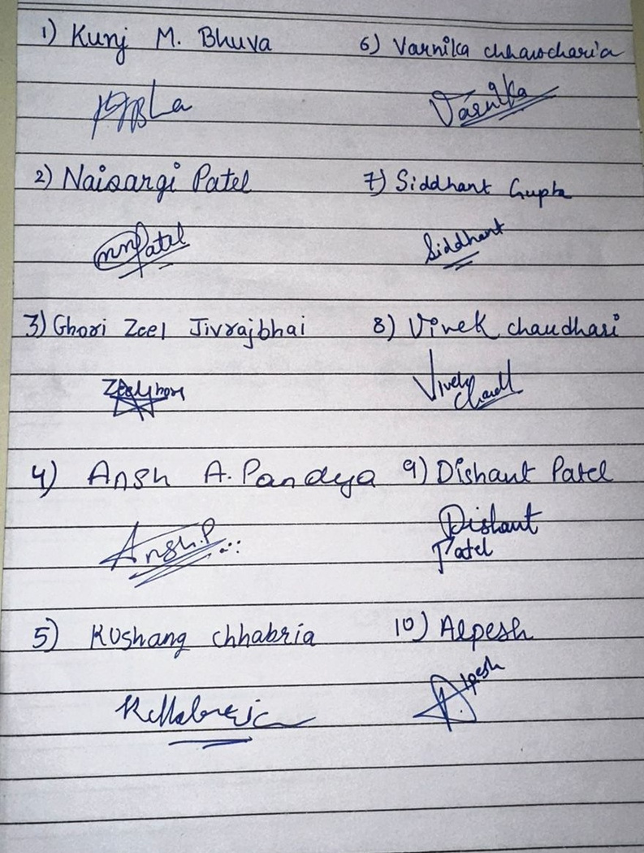
Our Team
Patel Dishant (202201260)
Yadav Alpheshkumar (202201264)
Varnika Chhawcharia (202201269)
Siddhant Gupta (202201272)
Kunj Bhuva (202201275)
Zeel Ghori (202201287)
Patel Naisargi (202201291)
Vivek Chaudhari (202201294)
Pandya Ansh (202201303)
Kushang Vivek (202201304)

Slide 5
5G TECHNOLOGY
5G (5th generation wireless systems) is the next major phase of mobile telecommunications standards. The scope of 5G will ultimately range from mobile broadband services to next-generation automobiles and connected devices.
The initial 5G New Radio (NR) specification was completed in June
2018 and published in the 3GPP Release 15 specification. Now, a
variety of industry players, including network equipment vendors,
network operators, semiconductor vendors, and device manufacturers,
are developing new products that implement the new standard.

Slide 6

CODING SCHEMES IN 5G
The 3rd Generation Partnership Project (3GPP) has chosen four coding schemes for 5G networks: LDPC, polar, convolutional, and turbo. These schemes are known for their performance and low complexity, which makes them a good choice for 5G. LDPC codes are used for user data, while polar codes are used for control information. LDPC codes are forward error correcting, which means they can efficiently correct transmission errors in noisy channels. Coding schemes in 5G technology provide increased speed and reliability, which allows developers to create applications faster and more responsively.

Slide 7
THEN WHAT IS LDPC ?
Low-density parity-check (LDPC) codes are a class of linear block codes that were first introduced by Gallager in his PhD thesis in 1960. The name comes from the characteristic of their parity-check matrix which contains only a few 1’s in comparison to the amount of 0’s.
Their main advantage is that they provide a performance which is very close to the capacity for a lot of different channels and linear time complex algorithms for decoding. Furthermore, they are suited for implementations that make heavy use of parallelism.

Slide 8
INTRODUCTION TO LDPC CODES
LDPC stands for “Low Density Parity Check”.
It is a special class of Linear block code with a sparse parity check matrix also known as LDPC matrix (H).
In H matrix, there are very few number of 1's as compared to 0's that’s why it is called Low Density Parity Check.
We represents LDPC codes by Tanner Graphs-a bipartite graphical structure.
It contains two types of nodes in the graph: Check nodes & Variable nodes.
Each Check node follows (n, n-1) SPC code.
Each Variable node follows repetition code.
We will see it later in this presentation.

Slide 9

REPRESENTATION OF LDPC
There are 2 different ways of representing LDPC code:
Linear block codes that are used via matrices
Second possibility is a graphical representation (Tanner Graph)

Slide 10
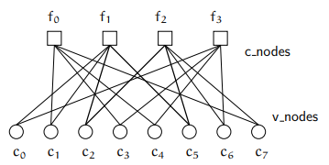
GRAPHICAL REPRESENTATION
Tanner introduced an effective graphical representation for LDPC Tanner codes.Tanner graphs are bipartite graphs. That means that the nodes of the graph are separated into two distinctive sets and edges are only connecting nodes of two different types. The two types of nodes in a Tanner graph are called variable nodes (v-nodes) and check nodes (c-nodes).
The creation of such a graph is rather straight forward. It consists of n check nodes (the number of parity bits) and m variable nodes (the number of bits in a codeword). Check node fi is connected to variable node cj if the element hij of H is a 1.
Variable nodes = Columns
Check nodes = Rows
Edges = 1's in H matrix
Degree of VNs = weight of column
Degree of CNs = weight of row

Slide 11
LDPC CODES IN STANDARDS
Protograph Construction
5G NR Standard
Base graphs for LDPC codes
Expanded by right shift permutation matrices
Optimized for Performance vs Complexity
Two base graphs
Several expansions
Shortening and puncturing for multiple rates

Slide 12

BASE MATRICES FOR LDPC 5G STANDARD
Two base matrices:
Block structure of base matrices
A E O
B C I
BG 1
BG 2
BG1: 46 × 68 & BG2: 42 × 52
A: 4 × 22, E: 4 × 4, 0: 4 × 42 (All zeros)
B: 42 × 22, C: 42 × 4, I: 42 × 42 (Identity)
A: 4 × 10, E: 4 × 4, 0: 4 × 38 (All zeros)
B: 38 × 10, C: 38 × 4, I: 38 × 38 (Identity)

Slide 13
EXPANSION FACTOR: Z
Index and expansion factors
For each Z, base matrix entries are as follows:
iLS: 0, 1, 2, 3, 4, 5, 6, 7
a: 2, 3, 5, 7, 9, 11, 13, 15
Ja: 7, 7, 6, 5, 5, 5, 4, 4
Z: a × 2 , j = 0, 1, 2, ..., Ja
j
Max Z = 384
-1, 0, 1, 2, ..., Z-1
-1 : Z × Z all zero matrix
k in [0, Z-1] : identity matrix shifted right by k positions

Slide 14
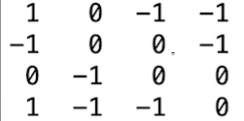
ENCODING BG1 AND BG2
The E segment of the base matrix is ​​an integral part of 5G communications. This is an important part because it has a double diagonal structure of zeros, as shown in the nearby image. When we calculate the dot product with the C matrix (codeword),later, adding all the equations, we will determine the first parity value. Later, all other parities are easier to determine because they depend on the previous i-1 equality.

Slide 15

BPSK MODULATION OVER AWGN CHANNEL
BPSK Modulator
AWGN Channel
Receiver
BPSK Demodulator
a
s
r(t)
r
a’
n(t)
a = bits to be transmitted (sequence of 0 and 1)
s = modulated message = (1 - 2×a)
n(t) = White Gaussian Noise
r(t) = s + n(t) = received noisy message
r = demodulated message
a’ = estimated value of transmitted bits
i.e., s = 1 , if a = 0
= -1 , if a = 1

Slide 16
AWGN AND SNR
After the bits are converted to symbols, noise is added to the original signal during transmission or reception or both. The noise added is independent from time to time and symbol to symbol. AWGN helps to predict system performance and design robust systems that can operate effectively even in the presence of noise.
Continuous-time AWGN channel:
P = Signal Power; N/2 = Noise Power Spectral Density; 2W = Bandwidth
SNR = P/(N*W)
Time per Symbol = 1/(2W)
Discrete-time AWGN channel:
Energy per Symbol, E = PT = P/(2W)
Noise energy = σ , Variance of noise n = N/2
N follows normal distribution with mean zero and variance σ
2
2

Slide 17
DEMODULATION
After adding AWGN to the modulated signal, the signal's amplitude fluctuates in the presence of noise. When the signal surpasses a certain threshold value, the corresponding bit is set to 1, while any remaining values are set to 0.
(for our reference the value of threshold is taken 0)
if(r>0)
a’ = 0
else
a’ = 1

Slide 18
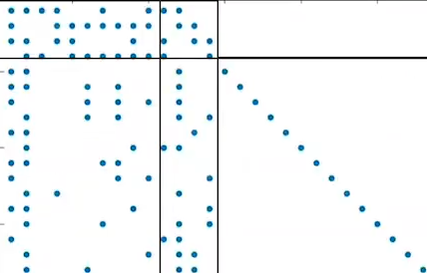
P U N C T U R I N G
A
In our Base matrix , we observe that the A segment has high density of non - zero values. This result in tedious calculations.
In order to match the code rate and make it more manageable, one strategy to apply is puncturing. By selectively removing certain bits, puncturing effectively alters the code rate while potentially simplifying the decoding process.

Slide 19
RATE MATCHING
Rate matching in LDPC involves adjusting the parity-check matrix to match the desired code rate. For large base matrices, this entails expanding or puncturing the matrix while maintaining sparsity. Expansion adds rows to increase rate, puncturing removes rows to decrease it. This process preserves the code's error-correction capability. Rate matching aligns LDPC codewords with the transmission rate, often involving padding or truncating. Optimization considers factors like error correction, decoding complexity, and system compatibility. LDPC codes are prevalent in communication standards like Wi-Fi and 5G NR. Effective rate matching ensures reliable performance in these systems.
[mb,nb] = size(B); kb = nb - mb; % 5G NR specific details
kNumInfoBits = kb * z; % Number of information bits
k_pc = kb-2; nbRM = ceil(k_pc/codeRate)+2; % Some 5G NR specific details
nBlockLength = nbRM * z; % Number of encoded bits

Slide 20
HARD DECISION DECODING
Hard decision decoding is a technique in digital communication where the received signal is compared to predefined thresholds to determine the transmitted symbol. By dividing the signal space into distinct regions based on these thresholds, the decoder can make a decision about the transmitted symbol. This method is straight forward and computationally efficient, making it suitable for various error-correcting codes. However, hard decision decoding may struggle in highly noisy or fading channels where softer decision metrics, such as likelihood ratios, are preferred.

Slide 21
SOFT DECISION DECODING AND LOG LIKELIHOOD RATIO
Soft decision decoding is a method used in digital communication to make decisions about transmitted symbols based on the likelihood of different symbols given the received signal. This is typically done using metrics like the log likelihood ratio (LLR), which quantifies the likelihood of each symbol based on the received signal's characteristics and noise statistics. Soft decision decoding provides more information about the reliability of each symbol, allowing for more accurate decoding in noisy or fading channels compared to hard decision decoding. However, it requires more computational resources and complexity due to the need to calculate and process LLRs for each symbol.

Slide 22
SISO DECODER FOR REPETITION CODE
Repetition
BPSK Modulator
AWGN Channel
SISO Decoder
m
c
s
r
L
n(t)
m = information bit
c = codeword of length n, generally repeated the m bit n times
r = s + n(t) = received noisy message
L = log likelihood ratio (LLR) = ℓ + ℓ = “belief” that the bit is 0
ℓ = intrinsic value
ℓ = extrinsic value
ext
ext

Slide 23
WHAT IS INTRINSIC AND EXTRINSIC VALUES?
Intrinsic Log Likelihood Ratio (LLR):
The intrinsic log likelihood ratio (LLR) of the i bit represents the confidence level that the bit is '0', solely based on the received value of r corresponding to that bit.
th
Extrinsic Log Likelihood Ratio (LLR):
The extrinsic log likelihood ratio (LLR) of the i bit represents the confidence level that the bit is '0', based on the received value of r but other than the corresponding bit.
th

Slide 24
COMPUTATION OF INTRINSIC AND EXTRINSIC VALUES
ℓ = log (P[c = 0 | r ])
(P[c = 1 | r ])
ℓ = log (P[r | c = 0]) = (2/σ ) r : where σ = variance of the AWGN
(P[r |c = 1])
Intrinsic LLR is also known as “Channel LLR” or “Input LLR”.
i
e
i
i
i
i
2
2
i
e
i
i
i
i
i
ℓ = log (P[c = 0 | r , r ,..., r , r ,..., r ])
ext
e
i
1
2
i-1
i+1
n
(P[c = 1 | r , r ,..., r , r ,..., r ])
ℓ = (2/σ ) (r + r +...+ r + r +...+ r )
i
1
2
i-1
i+1
n
2
ext
1
2
i-1
i+1
n
2
Log Likelihood Ratio (L) = (2/σ ) (r + r +...+ r )
L = ℓ + ℓ
It is also known as “Output LLR”.
1
2
n
ext

Slide 25
SISO DECODER FOR (N, N-1) SPC CODE
SPC
BPSK Modulator
AWGN Channel
SISO Decoder
m
c
s
r
L
n(t)
m = information bits of length (n-1)
c = codeword of length n, consisting of the parity bit
parity bit p = m ⊕ m ⊕ ... ⊕ m
r = s + n(t) = received noisy message
L = log likelihood ratio (LLR) = ℓ + ℓ = “belief” that the bit is 0
ℓ = intrinsic value
ℓ = extrinsic value
1
2
n-1
ext
ext

Slide 26
COMPUTATION OF INTRINSIC AND EXTRINSIC VALUES
ℓ = log (P[c = 0 | r ])
(P[c = 1 | r ])
ℓ = log (P[r | c = 0]) = (2/σ ) r ; where σ = variance of the AWGN
(P[r |c = 1])
i
e
i
i
i
i
2
2
i
e
i
i
i
i
i
To compute extrinsic LLR, first we compute,
ℓ = S sign(ℓ ) min(ℓ , ℓ , ..., ℓ )
We have approximated the value ℓ by “min-sum approximation”.
n
S = ∏ sign(ℓ )
i
i=1
ext,i
i
1
2
n
ext
2
Log Likelihood Ratio (L) = (2/σ ) (r + r +...+ r )
L = ℓ + ℓ
1
2
n
ext

Slide 27
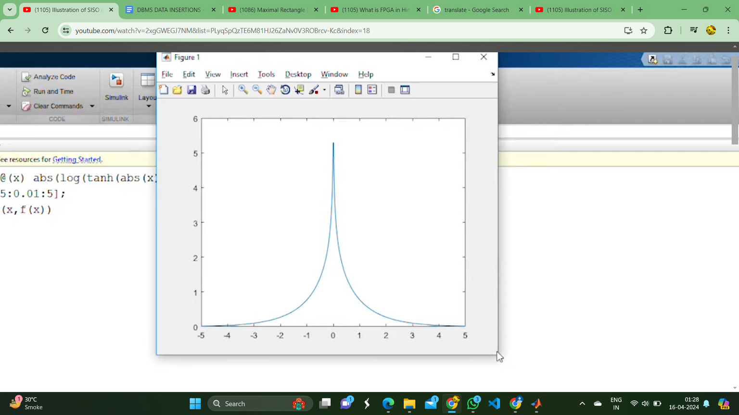
MIN-SUM APPROXIMATION
Let’s take an example of (3, 2) SPC code.
m = [m1 m2]
c = [c1 c2 c3] ; c1 = m1, c2 = m2, c3 = m1 ⊕ m2 (parity).
r = [r1 r2 r3] ; (real values)
L = [L1 L2 L3] ; Log Likelihood Ratio
L = ℓ + ℓ
ℓ1 = (2/σ ) r1, ℓ2 = (2/σ ) r2, ℓ3 = (2/σ ) r3.
sign(ℓ ) = sign(ℓ2) sign(ℓ3)
f(|ℓ |) = f(|ℓ2|) + f(|ℓ3|) ; where f(x) = log (tanh (|x|/2))
The fact about the function f(x) : f (x) = f(x)
|ℓ | = f( f(|ℓ2|) + f(|ℓ3|) )
We can approximate the above equation like this:
f(|ℓ2|) + f(|ℓ3|) ≈ f( min(|ℓ2|, |ℓ3|) )
|ℓ |= min(|ℓ2|, |ℓ3|)
f(x)
ext
2
2
2
ext,1
ext,1
x
-1
ext,1
ext,1

Slide 28
USE OF TANNER GRAPH IN HARD DECISION
In hard decision decoding, Tanner graphs illustrate the relationships between code bits (variable nodes) and check nodes, aiding the decoding process. Within Tanner graphs, check nodes employ Single Parity Check (SPC) decoding, whereas all variable nodes are decoded using the majority decoding technique. During SPC decoding, a check node disregards positive feedback from the variable node to which it sends information. Instead, it performs SPC decoding based on the bits received from other variable nodes. Similarly, variable nodes disregard positive feedback from the check node to which they send information. Instead, they conduct majority decoding using information from other check nodes and their current stored value. This iterative process enhances the decoding accuracy and efficiency of hard decision decoding algorithms in communication systems.

Slide 29
USE OF TANNER GRAPH IN SOFT DECISION
Tanner graphs incorporate soft decision metrics like log-likelihood ratios, enhancing error correction by considering signal uncertainties. The graph's structure influences computational complexity, with denser graphs requiring more iterations for error correction. Soft decision decoding aims to identify and correct errors in received codewords, enhancing communication system reliability. Tanner graphs aid in assessing LDPC code performance under various channel conditions, guiding error correction scheme design and optimization.

Slide 30
MONTE CARLO
A Monte Carlo simulation is a model used to predict the probability of a variety of outcomes when the potential for random variables is present. Monte Carlo simulations help to explain the impact of risk and uncertainty in prediction and forecasting models. Unlike a normal forecasting model, Monte Carlo Simulation predicts a set of outcomes based on an estimated range of values versus a set of fixed input values. In other words, a Monte Carlo Simulation builds a model of possible results by leveraging a probability distribution, such as a uniform or normal distribution, for any variable that has inherent uncertainty. It, then, recalculates the results over and over, each time using a different set of random numbers between the minimum and maximum values. His exercise can be repeated thousands of times to produce a large number of likely outcomes.

Slide 31
PERFORMANCE AND COMPLEXITY
Before describing encoding and decoding algorithms, I would like to explain why all this effort is needed. The feature of LDPC codes to perform near the Shannon’s limits of a channel exists only for large block lengths.
Since the complexity grows in O(n^2 ) even sparse matrices don’t result in a good performance if the block length gets very high. So iterative decoding (and encoding) algorithms are used. Those algorithms perform local calculations and pass those local results via messages. This step is typically repeated several times. The term ”local calculations” already indicates that a divide and conquer strategy, which separates a complex problem into manage- divide and able sub-problems, is realized.

Slide 32
H-MATRIX(9X12)
H = [1 0 0 0 0 1 0 1 0 1 0 0;
1 0 0 1 1 0 0 0 0 0 1 0;
0 1 0 0 1 0 1 0 1 0 0 0;
0 0 1 0 0 1 0 0 0 0 1 1;
0 0 1 0 0 0 1 1 0 0 0 1;
0 1 0 0 1 0 0 0 1 0 1 0;
1 0 0 1 0 0 1 0 0 1 0 0;
0 1 0 0 0 1 0 1 0 1 0 0;
0 0 1 1 0 0 0 0 1 0 0 1];
This H matrix have 9 rows and 12 columns. It means u = n - k = 9 and
n =12 which says there will be 3 message bits and 9 parity check bits. The weight of each row is 4 which tells that degree of each CN will be 4 and there will be 9 such CNs. Similarly the weight of each column is 3 which tells that each degree of each VN is 3 and there will be 12 such VNs.

Slide 33
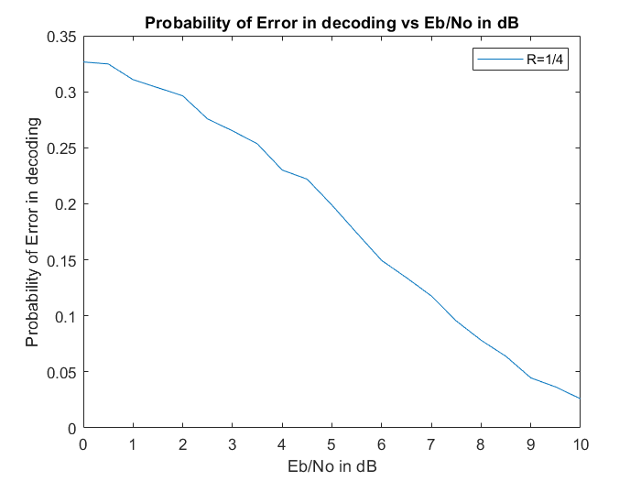
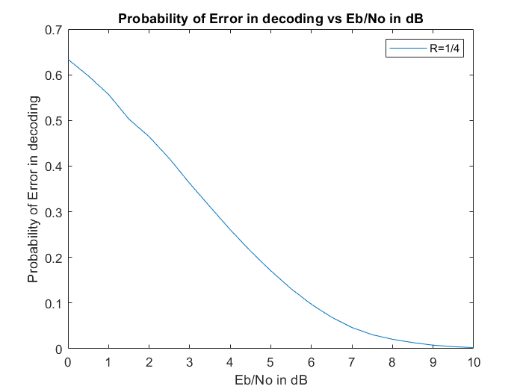
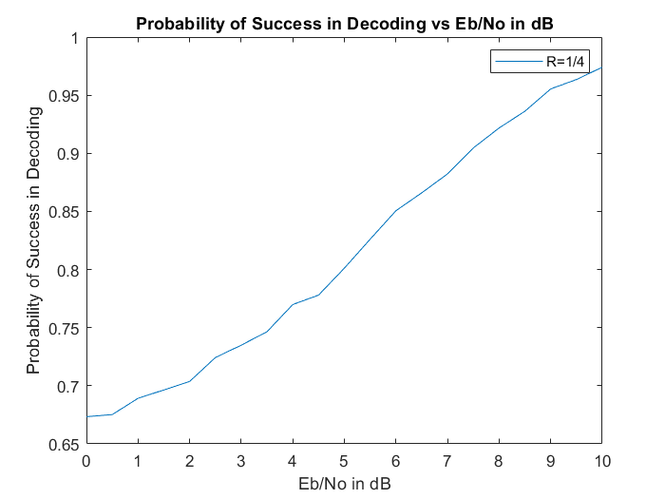
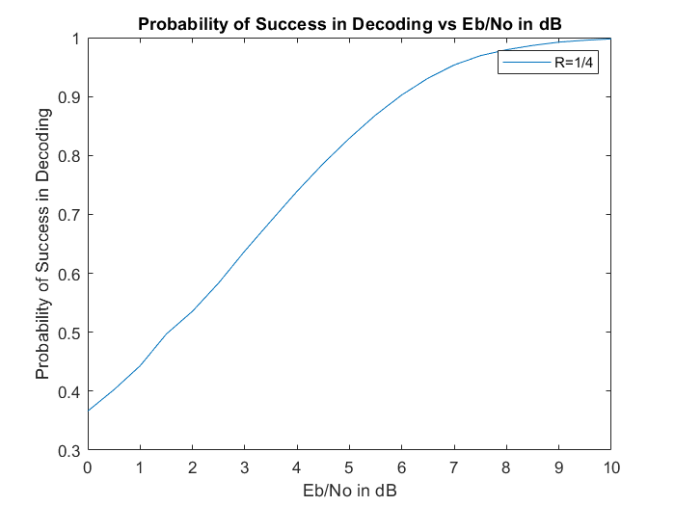
PROBABILITIES OF HARD DECISION DECODING FOR 9x12 H MATRIX FOR CODE RATE 1/4 USING TANNER GRAPH
PROBABILITIES OF SOFT DECISION DECODING FOR 9x12 H MATRIX FOR CODE RATE 1/4 USING TANNER GRAPH

Slide 34
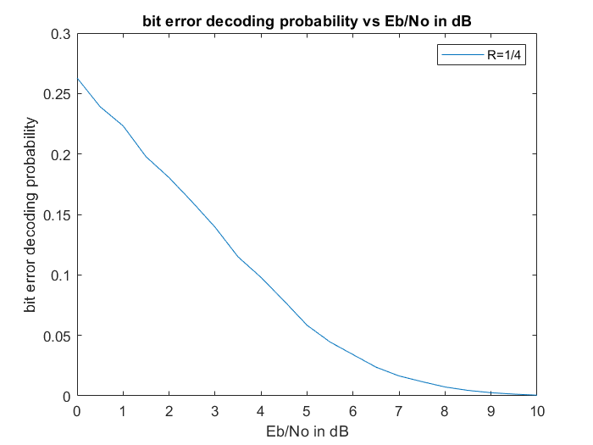
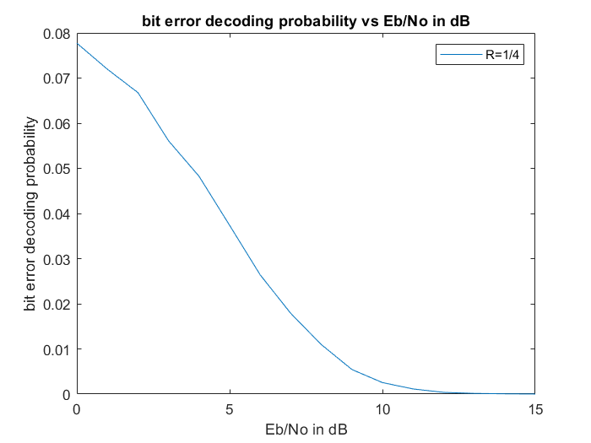
BEP (BIT ERROR PROBABILITY)
The BEP is influenced by various factors, including the signal-to-noise ratio (SNR), modulation scheme, coding scheme, channel characteristics, and error correction techniques employed. In general, as the SNR increases (meaning the signal becomes stronger relative to the noise), the BEP decreases, leading to better communication performance.
SOFT DECISION DECODING USING TANNER GRAPH
HARD DECISION DECODING USING TANNER GRAPH

Slide 35
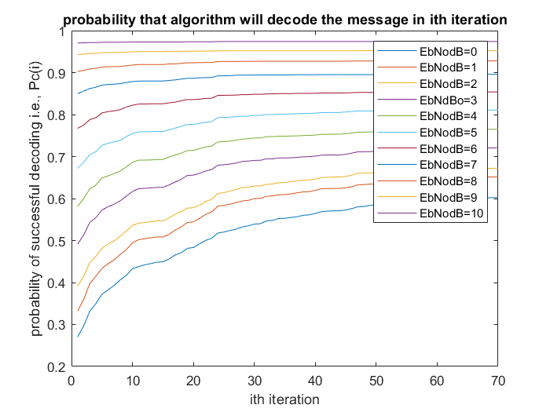
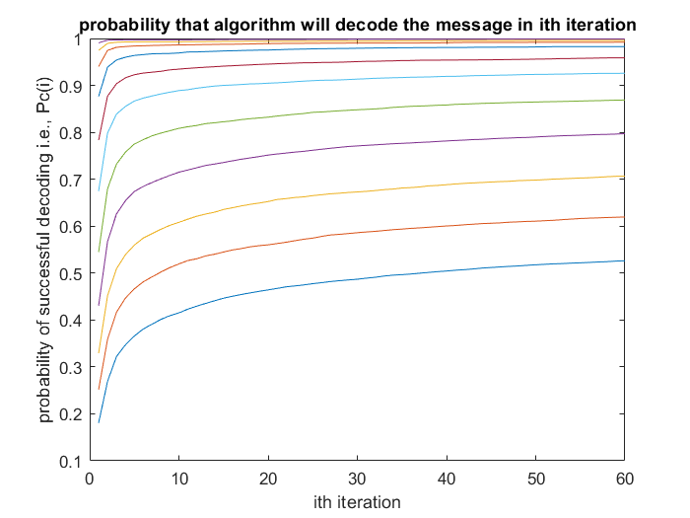
HARD DECISION DECODING
SOFT DECISION DECODING
USING TANNER GRAPH
USING TANNER GRAPH
This graph shows the probability of successful decoding at the ith iteration for both Hard and soft decision for various values of EbNo in dB for the code rate 1/4 for 9X12 H matrix.

Slide 36
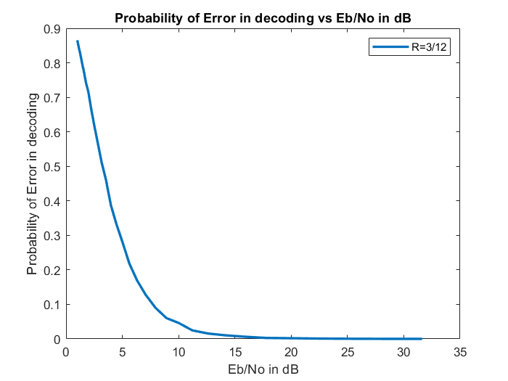
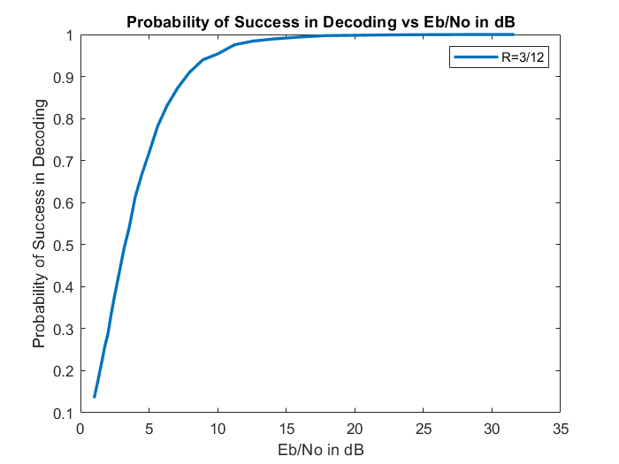
GRAPHS OF 9x12 H MATRIX USING METHOD 2 OF SOFT DECISION DECODING
This method is about iterative decoding of a low-density parity-check (LDPC) code using the sum-product algorithm. It iteratively calculates the likelihood ratios of received bits and updates them based on the parity-check matrix. It then decodes the message and evaluates the decoding performance in terms of success probability, error probability, and bit error probability for different signal-to-noise ratios. Finally, it plots these probabilities against the signal-to-noise ratio.

Slide 37
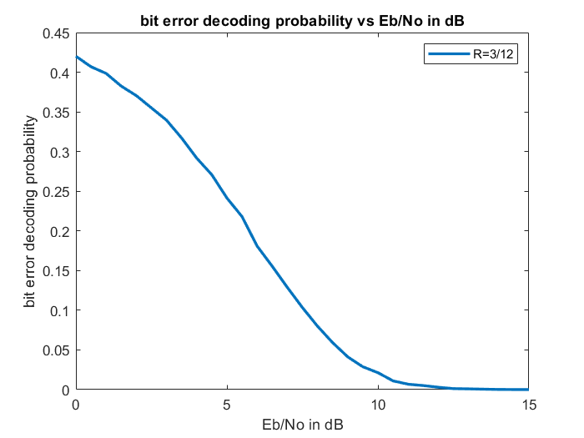
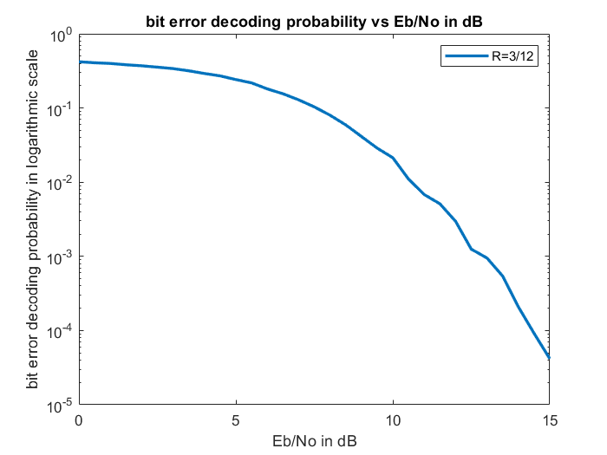
GRAPHS OF 9x12 H MATRIX USING METHOD 2 OF SOFT DECISION DECODING
In this both x axis and y axis is in linear scale i.e., BER and EbNodB is in linear scale
In this only x axis and is in linear scale and y axis is in logarithmic scale i.e., BER is in logarithmic scale and EbNodB is in linear scale

Slide 38
BASE MATRIX NR_2_6_52
INFORMATION ABOUT BASE MATRIX (BG2) :
iLS: 0, 1, 2, 3, 4, 5, 6, 7
a: 2, 3, 5, 7, 9, 11, 13, 15
Ja: 7, 7, 6, 5, 5, 5, 4, 4
Z: a × 2 , j = 0, 1, 2, ..., Ja
j
It belongs to the group number 6 of different expansions.
The value of a is 13.
Also the value of Ja is 4.
All possible expansion factors : 13, 26, 52, 104, 208.
For the BG2, expansion factor Z = 52

Slide 39
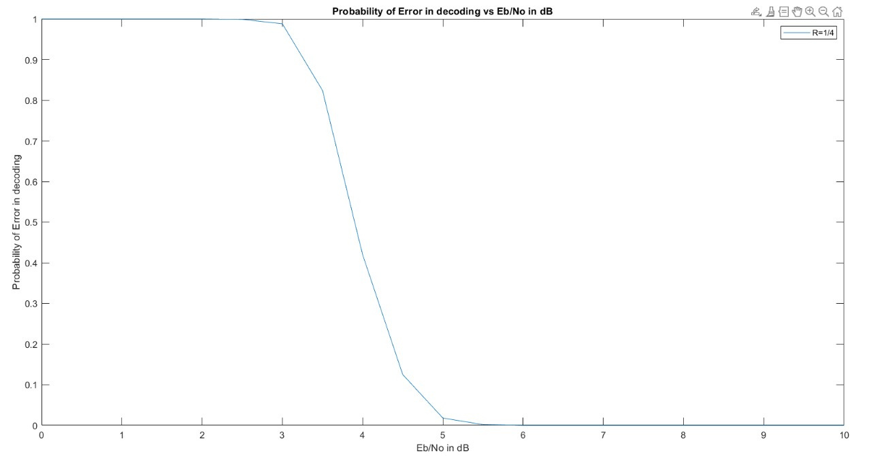
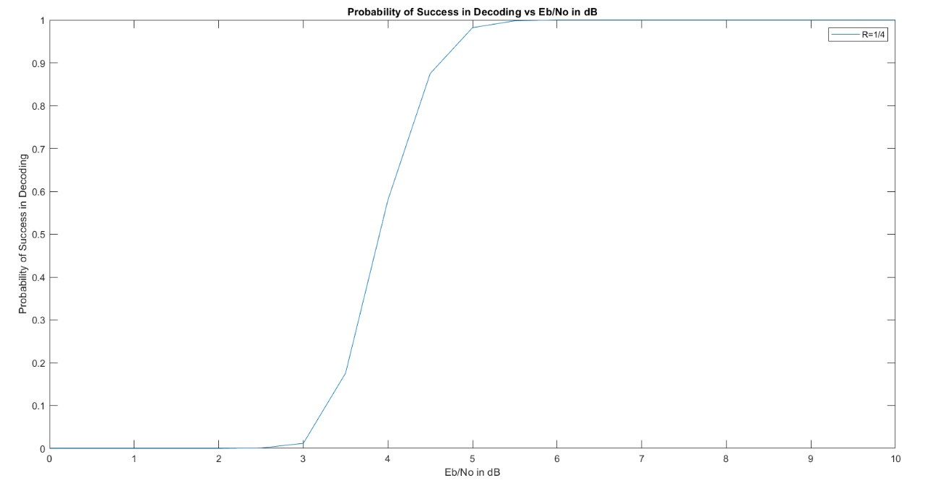
GRAPH OF PROBABILITIES OF SOFT DECISION DECODING FOR NR_2_6_52 MATRIX FOR CODE RATE 1/4

Slide 40
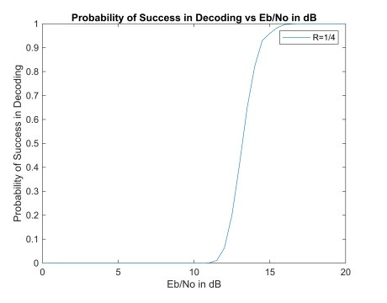
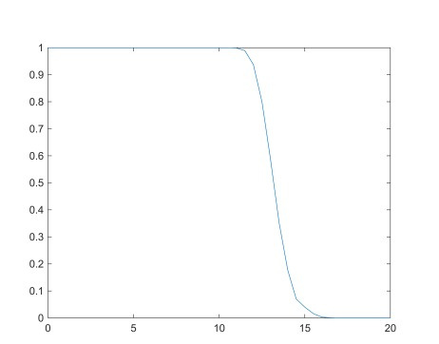
GRAPH OF PROBABILITIES OF HARD DECISION DECODING FOR NR_2_6_52 MATRIX FOR CODE RATE 1/4
Probability of Success in Decoding vs Eb/No in dB
Probability of Success in Decoding
Eb/No in dB

Slide 41
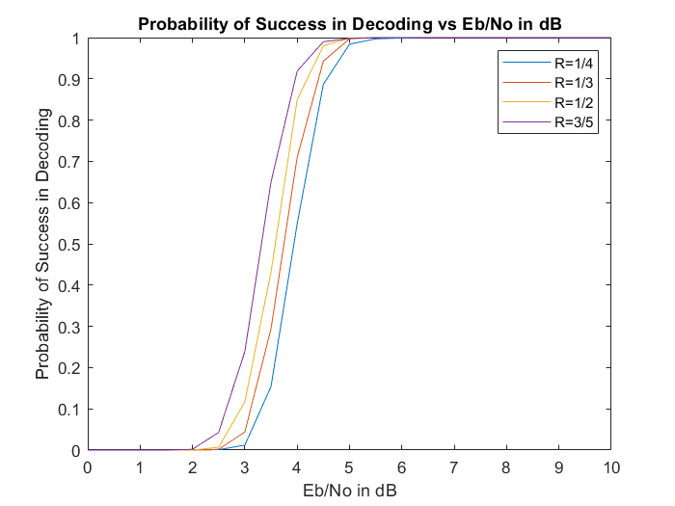
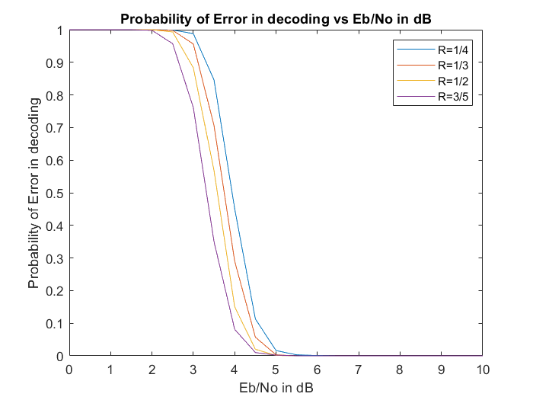
GRAPH OF PROBABILITIES OF SOFT DECISION DECODING FOR NR_2_6_52 MATRIX FOR VARIOUS CODE RATES

Slide 42
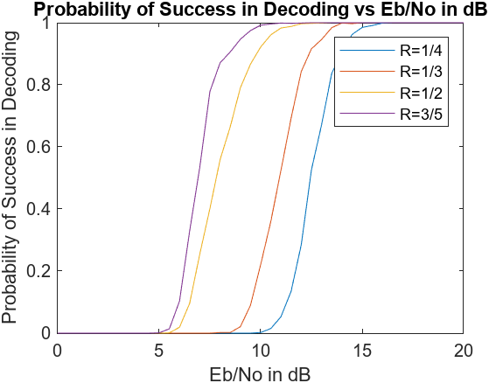
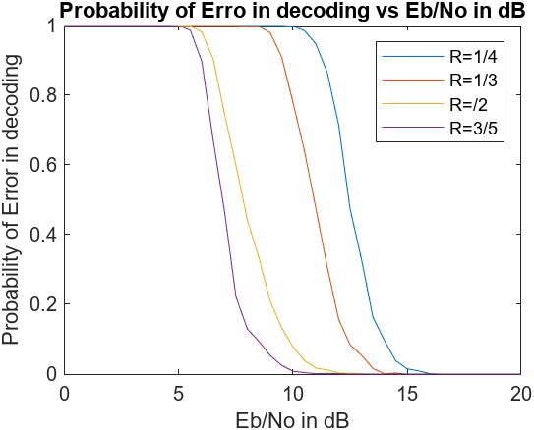
GRAPH OF PROBABILITIES OF HARD DECISION DECODING FOR NR_2_6_52 MATRIX FOR VARIOUS CODE RATES

Slide 43
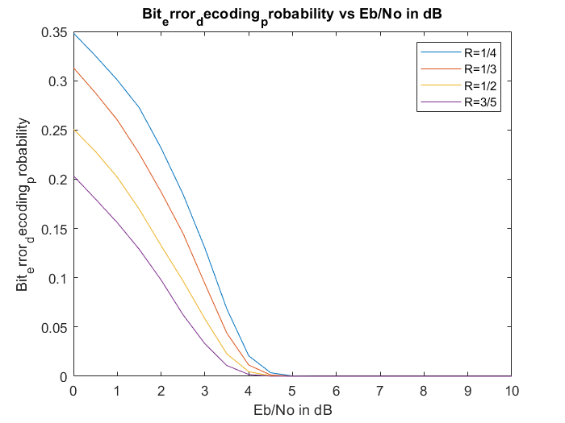
GRAPH OF BEP OF SOFT DECISION DECODING FOR NR_2_6_52 MATRIX FOR VARIOUS CODE RATES
Bit error decoding probability vs Eb/No in dB
Bit error decoding probability vs Eb/No in dB

Slide 44
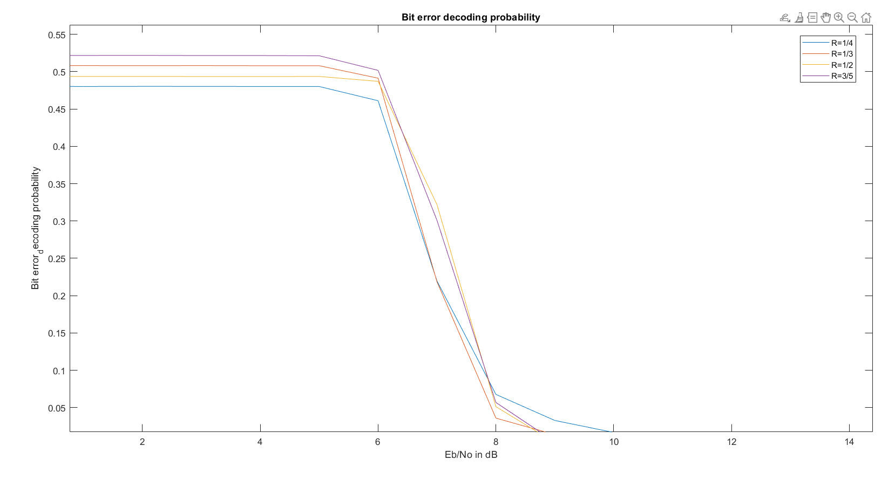
GRAPH OF BEP OF HARD DECISION DECODING FOR NR_2_6_52 MATRIX FOR VARIOUS CODE RATES

Slide 45
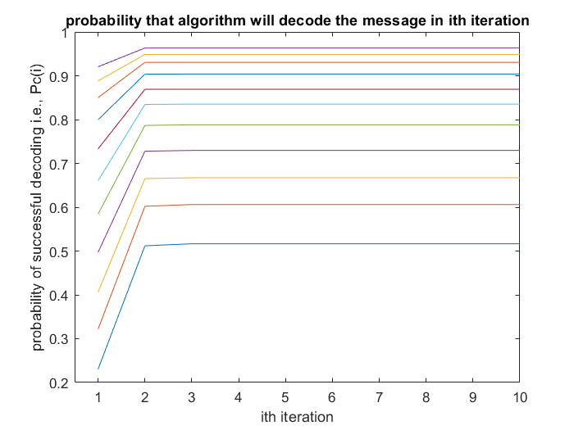
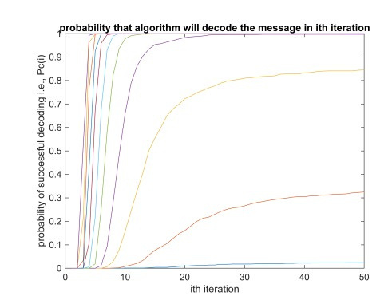
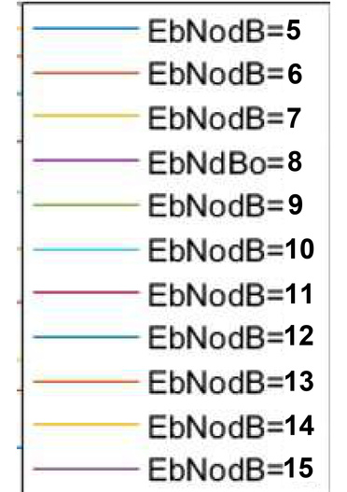
This graph shows the probability of successful decoding at the ith iteration for both Hard and soft decisions for N_2_6_52 for various values of EbNo in dB for the code rate 1/4
HARD DECISION
SOFT DECISION

Slide 46
BASE MATRIX NR_1_5_352
INFORMATION ABOUT BASE MATRIX (BG1) :
iLS: 0, 1, 2, 3, 4, 5, 6, 7
a: 2, 3, 5, 7, 9, 11, 13, 15
Ja: 7, 7, 6, 5, 5, 5, 4, 4
Z: a × 2 , j = 0, 1, 2, ..., Ja
j
It belongs to the group number 5 of different expansions.
The value of a is 11.
Also the value of Ja is 5.
All possible expansion factors : 11, 22, 44, 88, 176, 352.
For the BG1, expansion factor Z = 352

Slide 47
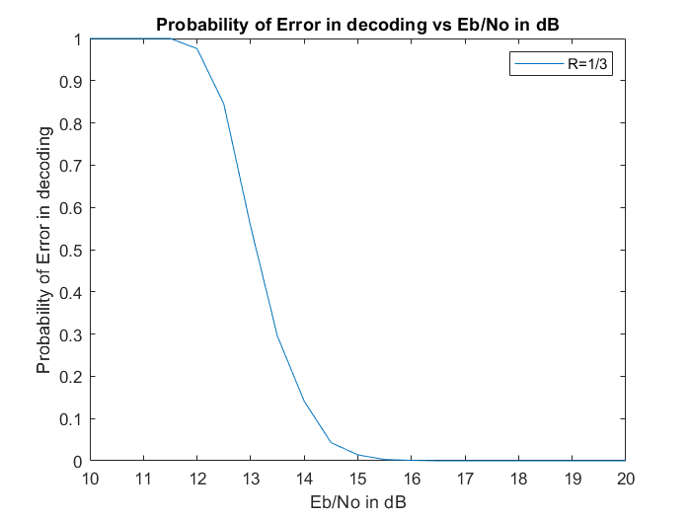
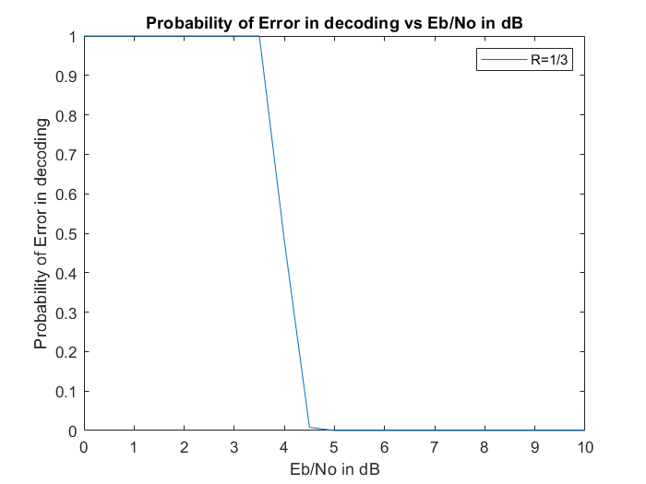
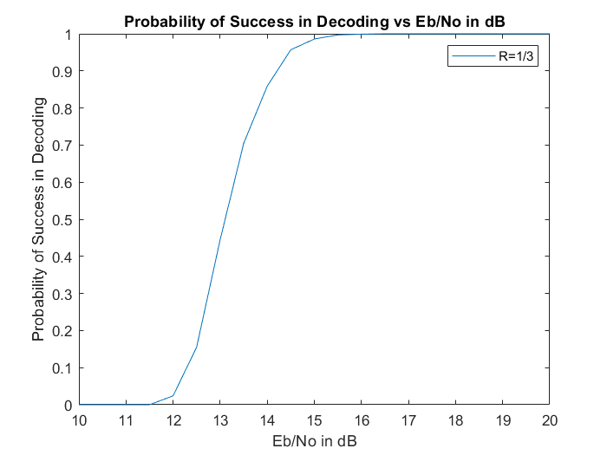
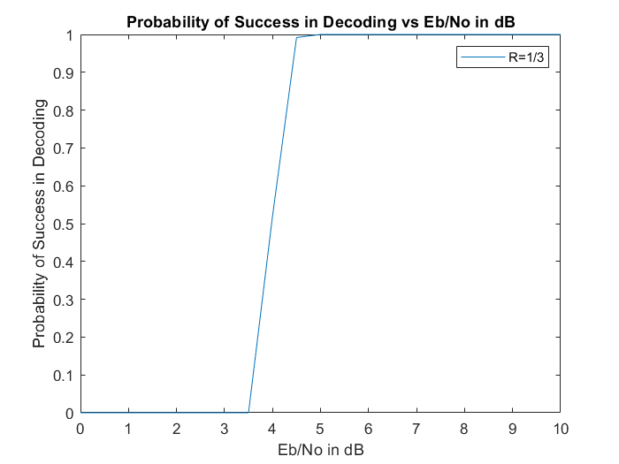
PROBABILITIES OF HARD DECISION DECODING FOR N_1_5_352 BASE MATRIX FOR CODE RATE 1/3
PROBABILITIES OF SOFT DECISION DECODING FOR N_1_5_352 BASE MATRIX FOR CODE RATE 1/3

Slide 48
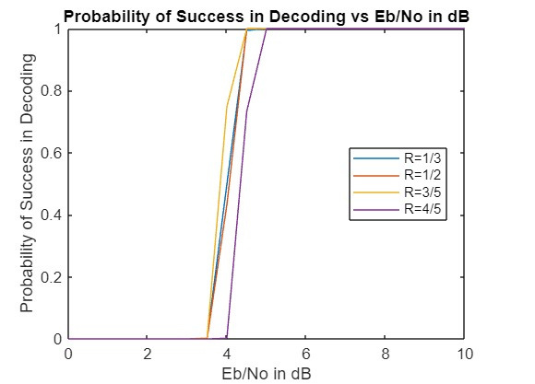
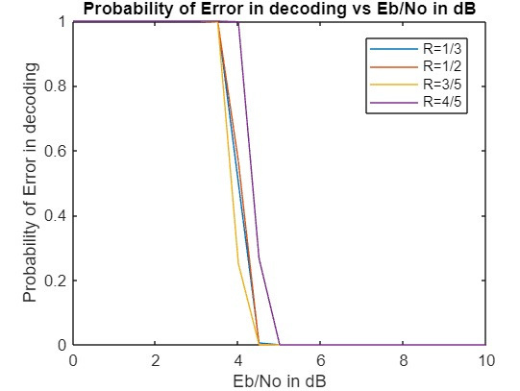
GRAPH OF PROBABILITIES OF SOFT DECISION DECODING FOR NR_1_5_352 MATRIX FOR VARIOUS CODE RATES

Slide 49
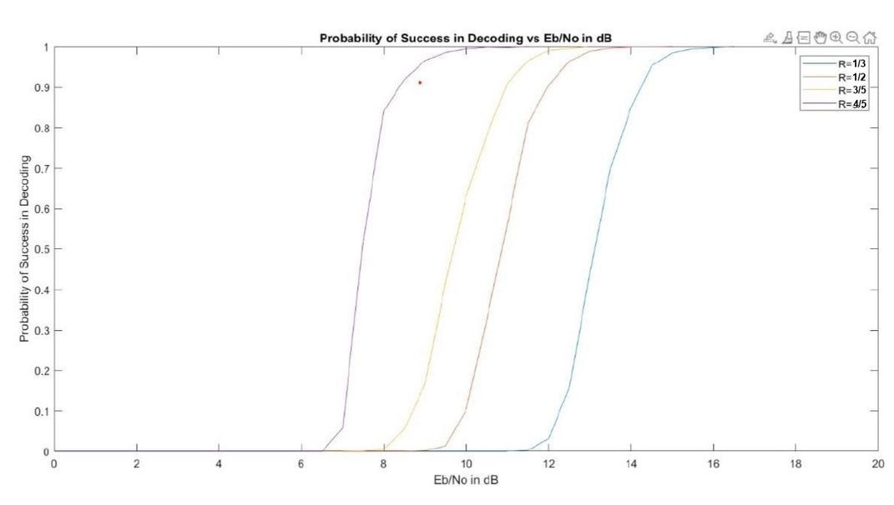
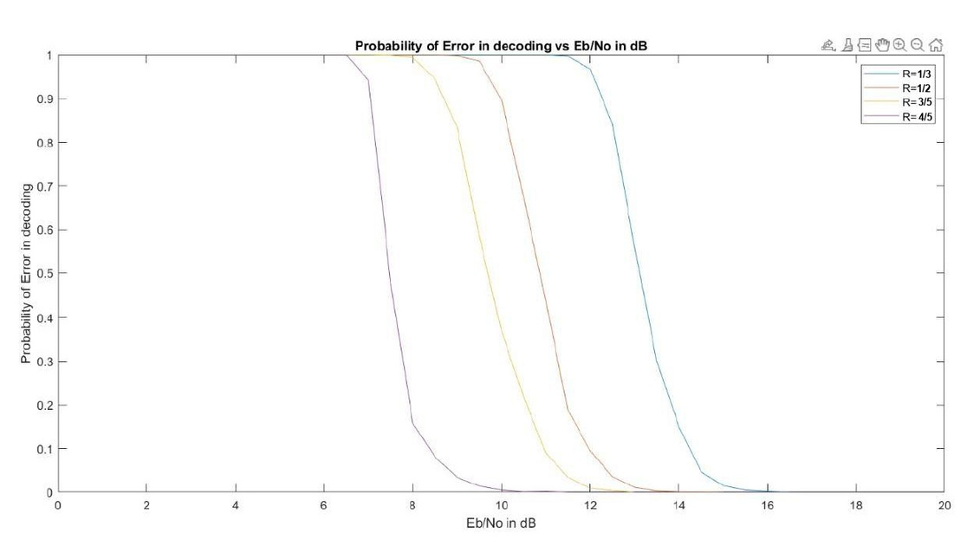
GRAPH OF PROBABILITIES OF HARD DECISION DECODING FOR NR_1_5_352 MATRIX FOR VARIOUS CODE RATES
HERE RATE = {1/3, 1/2, 3/5, 4/5}
As EbNo dB(SNR) increases the probability of successful decoding increases and also we can see that as rate increases even at lower EbNodB(SNR) we can have higher probability of successful decoding.

Slide 50
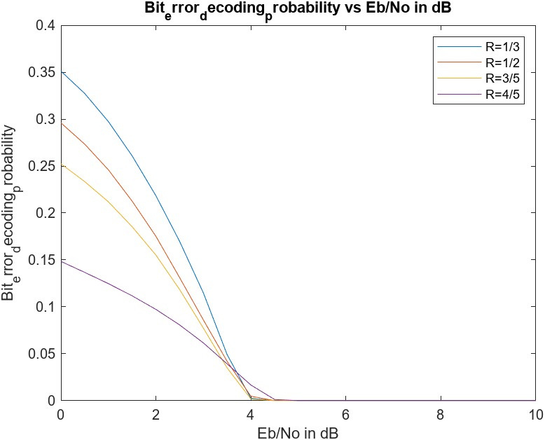
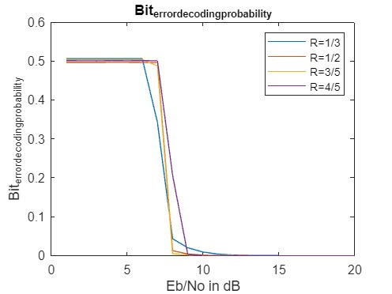
GRAPH OF BEP FOR NR_1_5_352 MATRIX FOR VARIOUS CODE RATES
Bit error decoding probability
Bit error decoding probability
Bit error decoding probability
Bit error decoding probability
SOFT DECISION DECODING
HARD DECISION DECODING

Slide 51
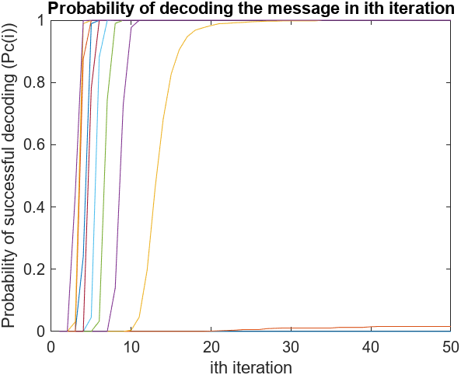
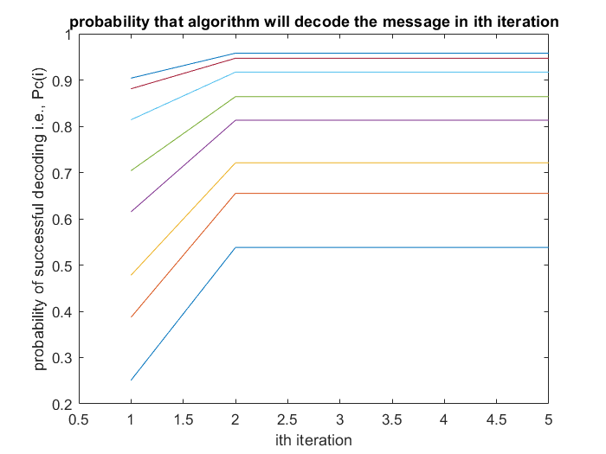
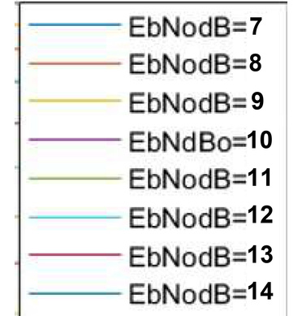
This graph shows the probability of successful decoding at the ith iteration for both Hard and soft decisions for N_1_5_352 for various values of EbNo in dB for the code rate 1/3
SOFT DECISION DECODING
HARD DECISION DECODING

Slide 52
BER VS SNR FOR BPSK OVER AWGN
By plotting BER against SNR, we can visualize how the error rate changes with the quality of the channel. At higher SNR, BER tends towards zero as the signal dominates the noise. At lower SNR, BER increases due to noise interference. The plot helps in analyzing the performance of the BPSK system over AWGN channel and in setting the required SNR for a desired BER.
For BPSK :
For Uncoded BPSK over AWGN (R=1) :
Signal Energy, Es is the mean of square of symbols = [(-1)^2 + (+1)^2] = 1
Noise Power = σ = N /2 where
SNR = Es/σ = 1/σ
1/σ = sqrt(SNR) = sqrt(2R (E /N ))
2
0
2
2
b
0
BER = Q(1/σ) = Q(sqrt(SNR)) = Q(sqrt(2 (E /N )))
b
0

Slide 53
BPSK Modulator
AWGN Channel
Receiver
BPSK Demodulator
a
s
r(t)
r
a’
n(t)
a = bit to be transmitted (0 and 1)
s = modulated message = (1 - 2×a)
n(t) = White Gaussian Noise
r(t) = s + n(t) = received noisy message
r = demodulated message
a’ = estimated value of transmitted bits
i.e., s = 1 , if a = 0
= -1 , if a = 1
i.e., a’ = 1 , if r < 0
= 0 , if r >= 0

Slide 54
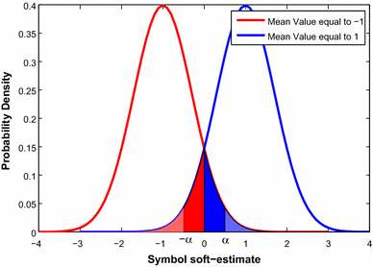
1/2
2
P[r | a=0] = (1/2πσ ) exp {(-1/2) ((r-1)/σ) }
Similarly, P[r | a=1] = (1/2πσ ) exp {(-1/2) ((r+1)/σ) }
Let’s assume that the priors are equally likely.
Maximum Likelihood Ratio: λ = P[ a=0 | r ] / P[ a=1 | r ]
= P[ r | a=0 ] / P[ r | a=1 ]
= exp (( 2r/σ ))
Log Likelihood Ratio (LLR): L = log (λ) = ( 2r/σ )
For BPSK, bit error of the received bit can be said as the probability that r falls on the wrong side of the decision boundary.
BER = P[ a=1, e=1 ] + P[ a=0, e=1 ]
2
2
1/2
2
2
2
e
if L > 0 ⇒ r >= 0
L < 0 ⇒ r < 0
i.e., r = 0 is the desicion boundary
image is taken from

Slide 55
BER = P[ a=1 ] P[ e=1 | a=1 ] + P[ a=0 ] P[ e=1 | a=0 ]
= 0.5 (P[ e=1 | a=1 ] + P[ e=1 | a=0 ])
= 0.5 (P[ r>0 | a=1 ] + P[ r<0 | a=0 ])
Also, 0.5 (P[ r>0 | a=1 ] = P[ r<0 | a=0 ])
BER = Q(1/σ) ; Q(x0) function gives the area of the graph of probability density function of the random variable taking values from x0 to ∞.
It states the probability that the value of the random variable will be greater than x0.
Two in-built MATLAB functions to compute Q(x0) value.
erfc(x0) = (2/√π) ∫ exp { -x } dx, Q(x0) = 0.5 (erfc(x0/√2))
∞
1/2
2
BER = P[ r>0 | a=1 ] = ∫ (1/2πσ ) exp {(-1/2) ((r+1)/σ) } dr
= Q(1/σ) ; where Q(x0) = ∫ (1/2π) exp { -x /2 } dx
2
0
∞
1/2
2
x0
∞
2
x0

Slide 56
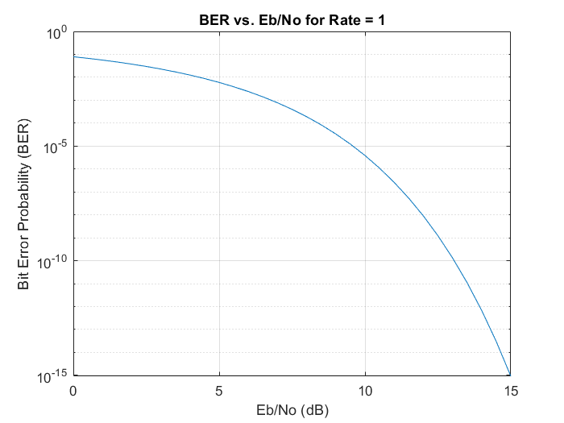
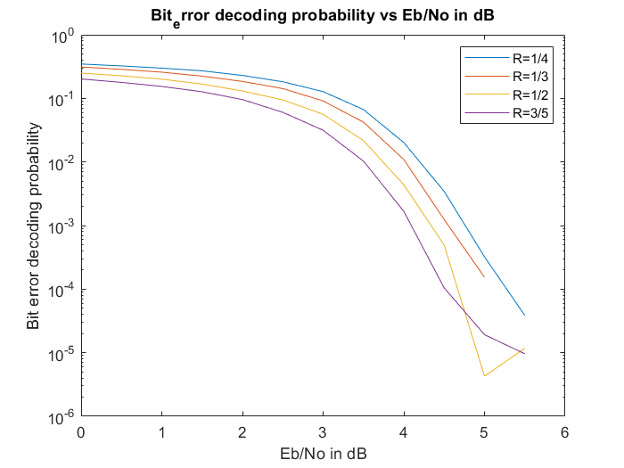
Comparing the simulation results of encoded and uncoded code for NR_2_6_52
A semilogarithmic plot using the semilogy function. This function is particularly useful when you have data that spans several orders of magnitude and you want to visualize it on a logarithmic scale along the y-axis.

Slide 57
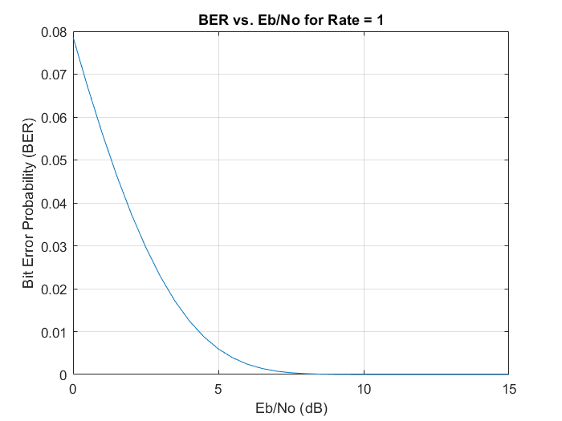
Comparing the simulation results of encoded and uncoded code for NR_2_6_52
Here the y axis is taken in linear scale and x axis is also taken in linear scale

Slide 58
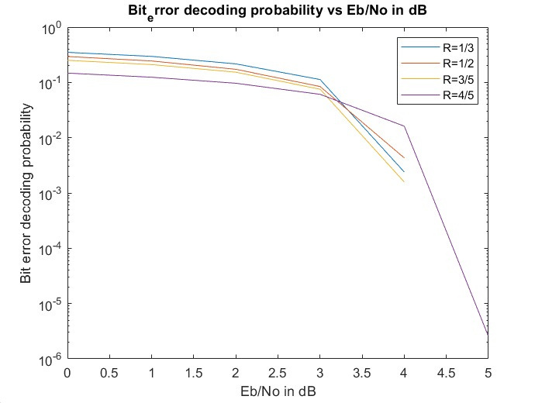
Comparing the simulation results of encoded and uncoded code for NR_1_5_352
A semilogarithmic plot using the semilogy function. This function is particularly useful when you have data that spans several orders of magnitude and you want to visualize it on a logarithmic scale along the y-axis.

Slide 59
Comparing the simulation results of encoded and uncoded code for NR_1_5_352
Here the y axis is taken in linear scale and x axis is also taken in linear scale

Slide 60
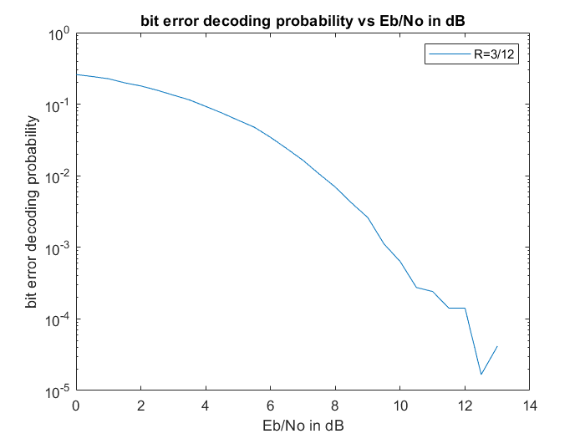
Comparing the simulation results of encoded and uncoded code for 9X12 H matrix
A semilogarithmic plot using the semilogy function. This function is particularly useful when you have data that spans several orders of magnitude and you want to visualize it on a logarithmic scale along the y-axis.

Slide 61
Comparing the simulation results of encoded and uncoded code for 9X12 H matrix
Here the y axis is taken in linear scale and x axis is also taken in linear scale

Slide 62
Benefits of encoded message over uncoded message
Encoding in communication systems introduces redundancy to aid error detection and correction. Higher parity bits provide more redundancy, allowing for a lower Bit Error Rate (BER) at lower Eb/No values. This occurs because additional redundant bits offer better error correction capabilities, mitigating noise effects. However, higher redundancy results in reduced data rate throughput due to increased redundancy. Conversely, a lower number of parity bits sacrifice some error correction for higher data rates. System designers must balance these trade-offs based on specific requirements like acceptable BER, available bandwidth, and power limitations. Adjusting encoding rates optimizes BER performance for given Eb/No levels, ensuring reliable communication in noisy environments. By choosing the appropriate encoding scheme, communication systems can achieve efficient data transmission with minimal errors.

Slide 63
Shannon Capacity bound
In LDPC coding, the Shannon capacity bound signifies the theoretical limit of reliable information transmission over a channel with noise. LDPC codes aim to approach this bound closely, maximizing data rates while ensuring reliability. They are designed to achieve near-optimal performance, particularly for large block lengths. By utilizing efficient encoding and decoding algorithms, LDPC codes can operate within a range of the Shannon capacity bound, maximizing data throughput while maintaining error correction capability. For even small change (increase) in SNR the BER drops to zero and make it error less channel.

Slide 64
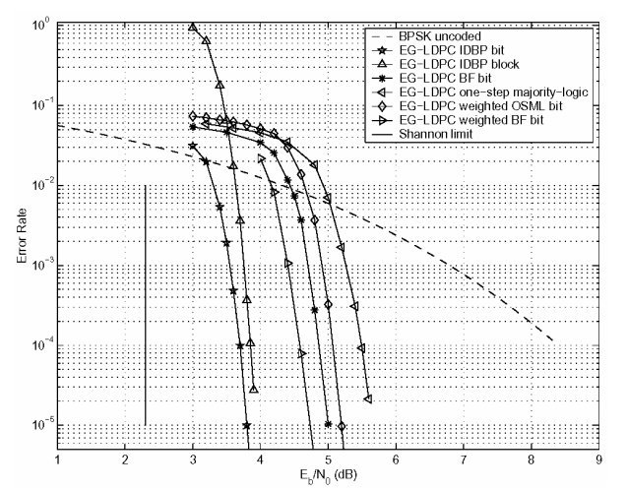
COMPARING THE SIMULATION RESULTS WITH THE SHANON CHANNEL CAPACITY BOUND
Low Density Parity Check Codes: Bandwidth Efficient Channel Coding

Slide 65
Conclusion of analysis
Performance Proximity: Both soft and hard decision decoding approaches for LDPC with large base matrices closely approach the Shannon capacity bound, indicating near-optimal performance.
Trade-offs: While soft decoding generally outperforms hard decoding, especially in low signal-to-noise ratio (SNR) scenarios, the performance gap diminishes with larger matrices, suggesting potential convergence in efficiency.
Complexity Considerations: Hard decision decoding offers simplicity and lower computational load compared to soft decision decoding, making it suitable for resource-constrained environments. However, soft decision decoding provides better error correction capabilities, crucial for low SNR environments.
Practical Applications: The choice between soft and hard decision decoding depends on specific system requirements. While hard decision decoding may be preferred for applications with limited computational resources or real-time constraints, soft decision decoding is advantageous for scenarios demanding maximum error correction performance despite higher complexity.

Slide 66
IMPROVEMENT IN THE MIN-SUM DECODING
The decoding process in LDPC typically involves iteratively passing messages between VNs and CNs until a valid codeword is found. The Min-Sum algorithm is a popular method for decoding LDPC codes due to its simplicity and effectiveness.
Offset Min-Sum is an enhancement of the traditional Min-Sum algorithm, aimed to improve its performance.
Offset Min-Sum introduces an offset parameter to the messages exchanged between variable nodes and check nodes.
This offset is used to bias the messages, typically towards zero, to avoid premature convergence to incorrect solutions.
The offset can be a fixed value or dynamically adjusted during the decoding process based on factors like the signal-to-noise ratio or decoding progress.
The offset can help the algorithm converge more reliably and efficiently, particularly in scenarios with high noise levels or difficult LDPC code configurations.

Slide 67
BIBLIOGRAPHY
Bernhard Leiner. LDPC codes – a brief tutorial. Self Study Project, 2005
J. G. Proakis. Digital Communications. McGraw-Hill, 4th edition, 1995.
Reference playlist : https://www.youtube.com/playlist?list=PLyqSpQzTE6M81HJ26ZaNv0V3ROBrcv-Kc
Low Density Parity Check Codes: Bandwidth Efficient Channel Coding

Slide 68
Thank you!
Course : CT-216 (INTRODUCTION TO COMMUNICATION SYSTEMS)
Lab Group-4 (Subgroup-2)
Mentor : Khushi Shah
Under the guidance of Prof. Yash Vasavada

